Slide 1

Grammar & Basics
Adverb vs Adjectives

Slide 2

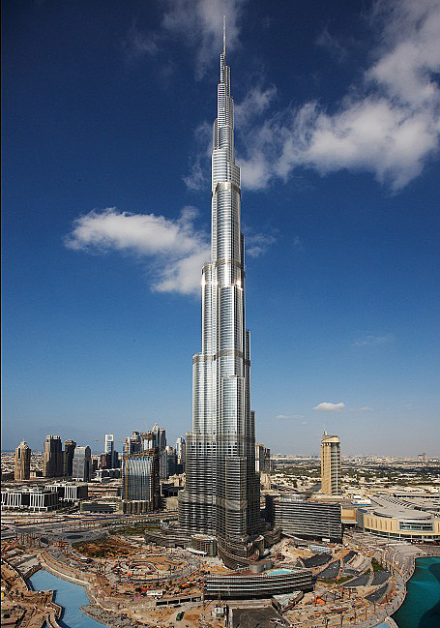
Comparisons

Slide 3
Comparison
Comparative:
That tower is taller than most other towers.
Superlative:
But this tower is the tallest.

Slide 4
Comparison
Rules
1 syllable → -er and –est She is bigger than her brother. She is the biggest.
2 syllables→ -er and -est or more/most He is funnier than his sister His uncle is the funniest She is more famous than you They are the most famous
3+ syllables → more and most They are more beautiful than her She is the most beautiful

Slide 5
Some spelling rules
Words that end in -e →-r, -st
wider, later, larger
Words ending in vowel + consonant (big, wet, thin) double the consonant →
bigger, wetter, thinner
Words ending in -y → -ier, iest
easier, heavier, luckier

Slide 6
Comparison – Two syllables
- er and - est
She is funnier than her brother.
OR more and most
She is more famous than her brother.

Slide 7
Comparison – Two syllables
le | simple – simpler – simplest
er | clever – cleverer – cleverest
y | happy – happier – happiest
ow | yellow – yellower – yellowest
-some | handsome – handsomer - handsomest

Slide 8
Comparison – Three syllables
more and most
She is more intelligent than her brother.
She is the most intelligent.

Slide 9
Irregular Forms
Bad – worse – worst
Far – farther – farthest
Far – further – furthest
Good – better – best
Little – less – least
Many – more – most
Much – more – most
Old – older – oldest
Old – elder – eldest
Notes:
Far farther farthest → distance only
Far further furthest → distance and addition
Older elder eldest → only before these nouns: son, daughter, brother, sister, child

Slide 10
Adverbs Form
Some adverbs mean something else if you add -ly
She worked very hard.
She hardly worked.
He is working late tonight.
Have you seen him lately.

Slide 11
Adverbs form
One adjective has a completely different from as its adverb
That was a good show
They played very well.

Slide 12
Adverbs Form
Many adverbs not based on adjectives
I’m leaving soon.
Theo rather likes brownies.
She is very pretty.
I don’t quite see your point.

Slide 13
Comparing with adverbs
Adverbs that end in -ly always get more and most
The girl danced more beautifully than the others
This fox moves more quickly than that one
Adverbs that don’t end in -ly work like adjectives
He worked harder than me
They just played better than us
So: well - better - best

Slide 14
When to use Adverbs VS Adjectives
paraphrase | example
How …? | He did it perfectly The painted the chair carefully
Where …? | They littered everywhere You can put that here
When …? | We saw that yesterday We never liked him anyway
paraphrase | example
What kind of/sort of/type of? | Green, perfect,

Slide 15
Common exception: ‘to be’ and similar verbs

Slide 16
Exercises: comparatives (see handout) Fill in the correct form…
1. She was ___________ (pretty) girl of all, at the party last night.
2. Pretty?? Try gorgeous! She was ___________ (gorgeous) one there.
3. Anyway, I think it was probably ___________ (good) party I’ve even been to.
4. Hmm, I disagree. My brother’s recent birthday party was ___________ (good) and simply ___________ (fun) than last night’s party.
5. But didn’t you think the band played ___________ (beautiful)?
6. Yes, they played far ___________ (skillful) than the typical “party band”.
7. They played their songs ___________ (fast) than most bands would dare to.
8. Contrast that with last week, when I heard just about ___________ (bad) band I’d ever heard in my life. I left after only four songs.

Slide 17
Answers
1. She was the prettiest (pretty) girl of all, at the party last night.
2. Pretty?? Try gorgeous! She was the most gorgeous (gorgeous) one there.
3. Anyway, I think it was probably the best (good) party I’ve even been to.
4. Hmm, I disagree. My brother’s recent birthday party was better (good) and simply more fun (fun) than last night’s party.
5. But didn’t you think the band played beautifully (beautiful)?
6. Yes, they played far more skillfully (skillful) than the typical “party band”.
7. They played their songs faster (fast) than most bands would dare to.
8. Contrast that with last week, when I heard just about the worst (bad) band I’d ever heard in my life. I left after only four songs.

